Slide 1
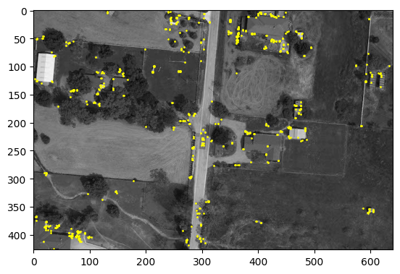
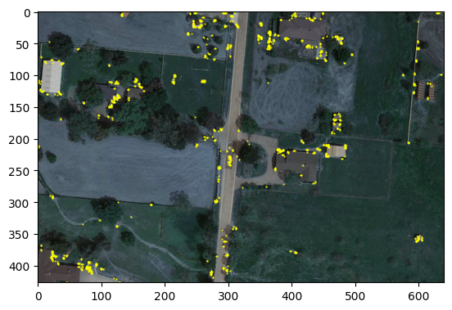
My Corner Detector
cv2 Corner Detector

Slide 2
